Slide 1

HACK MY RIDE INFO-H423-Data Mining
Presented By:
Tejaswini Dhupad
Khushnur Binte Jahangir
Himanshu Choudhary
Md Jamiur Rahman Rifat

Slide 2






TASKS
Task 1:Speed Analysis
Task 2:Delay Analysis
Task 3:Arrival Time Prediction
Task 4:Mode of Transportation

Slide 3
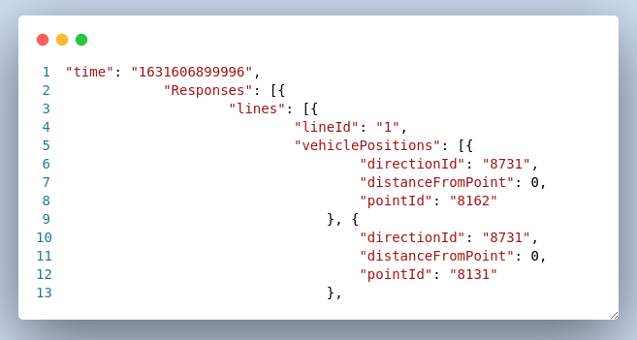
DATA PREPROSESSING
1.Data Information
File Format
Vehicle Location -JSON
GTFS File
Esri shape file
GPS Tracks - 9

Slide 4


2.Data Flattening
13 JSON Files
CSV Files
directionId | distancefrompoint | pointid | line_id | timestamp | day | time
8161 | 1 | 8012 | 1 | 16332732124 | 2021-09-06 | 07:54:32.33
8162 | 0 | 8142 | 1 | 16332732124 | 2021-09-06 | 07:54:32.33
8162 | 0 | 8282 | 1 | 16332732124 | 2021-09-06 | 07:54:32.33
8731 | 0 | 8111 | 1 | 16332732124 | 2021-09-06 | 07:54:32.33
8162 | 1 | 8062 | 1 | 16332732124 | 2021-09-06 | 07:54:32.33
8731 | 0 | 8281 | 1 | 16332732124 | 2021-09-06 | 07:54:32.33

Slide 5
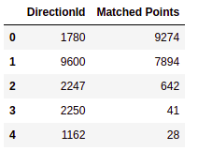
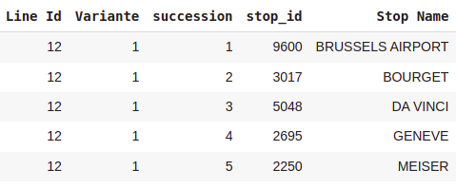
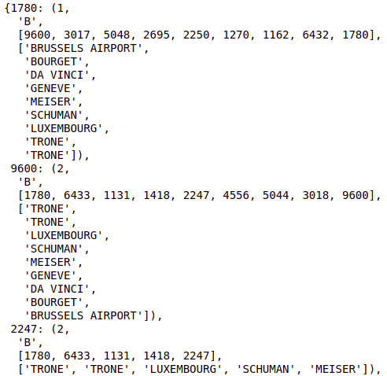
3.Vehicle Segregation
1. For Each Day Each line ID Separate all the Data points based on Direction ID (Ex - Line ID 12)
2.Using MIVB stopshape file assign the sequence to each Direction ID

Slide 6
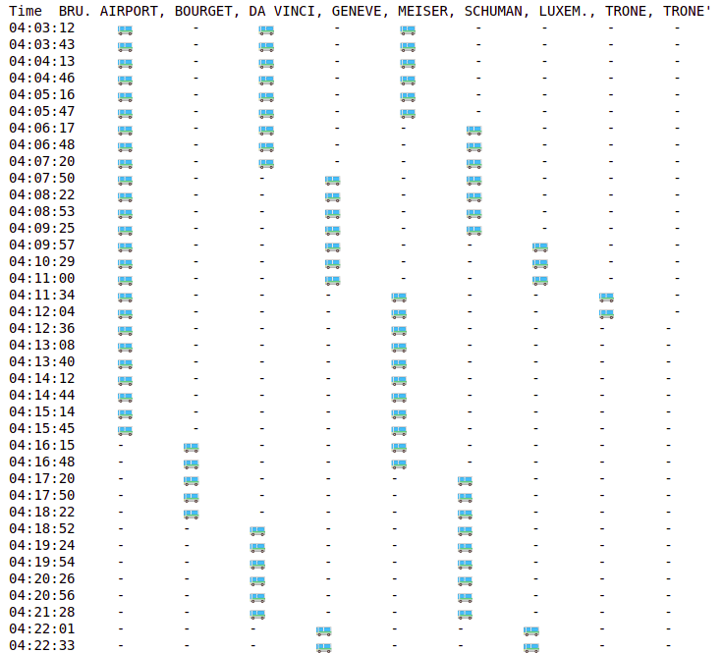
Algorithm:
Start the vehicle journey from the first appeared point
Locate the vehicle for each 30-second timestamp based on stop sequence, either vehicle will be in the same position or it will move to the next stop
Complete the journey if the vehicle reaches the last stop or if it disappears.

Slide 7
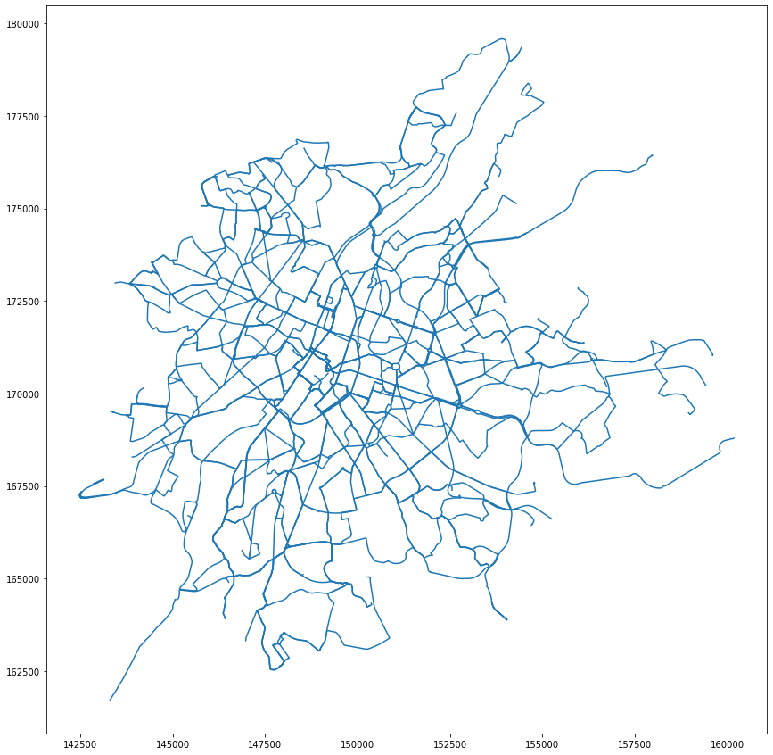
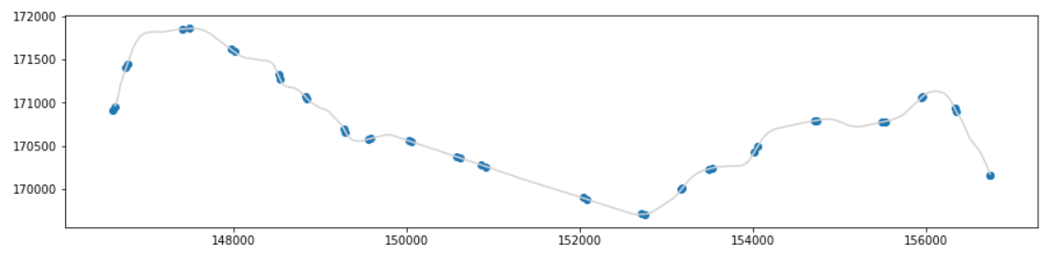
4.Distance Calculation
Algorithm
For each Line string
Project its associated stops to line
Get the distance of the point from the route starting point for each stop

Slide 8
Task 1: Speed Analysis

Slide 9
SPEED ANALYSIS - VISUALIZATION

Slide 10
Task 2: Delay Analysis

Slide 11
DELAY ANALYSIS
On-Time
Delay
Early
12:10
12:17
12:19
12:10
12:15
12:20

Slide 12
stop_times.txt
trip_id
arrival_time
stop_id
stop_trips
trip_id
arrival_time
stop_id
route_id
service_id
INNER JOIN
updated_stop_times.csv
route_id
trip_id
arrival_time
stop_id
service_id
line_id
trips.txt
INNER JOIN
trip_id
route_id
service_id
routes.txt
route_id
line_id

Slide 13
2021-09-06.csv
Get Day
Monday
2021-09-07.csv
2021-09-08.csv
2021-09-09.csv
2021-09-10.csv
2021-09-11.csv
Matching
2021-09-12.csv
service_id_df
…
service_id
…
…
…
…
2021-09-21.csv
calender.txt
monday
tuesday
sunday
service_id
…

Slide 14
temp_stop_times_df
updated_stop_times.csv
route_id
trip_id
arrival_time
stop_id
service_id
line_id
route_id
trip_id
arrival_time
stop_id
service_id
line_id
Standard_arrival_time
sta_arrival_time
INNER JOIN
service_id_df
2021-09-06.csv
service_id
stop_id
line_id
vehi_arrival_time

Slide 15

2021-09-06.csv
stop_id
line_id
vehi_arrival_time
vehi_arrival_time > sta_arrival_time
Least time_diff
YES
Delay
standard_arrival_time
sta_arrival_time
NO
For-loop
Early

Slide 16
DELAY ANALYSIS - VISUALIZATION

Slide 17
Task 3: Arrival Time Prediction

Slide 18
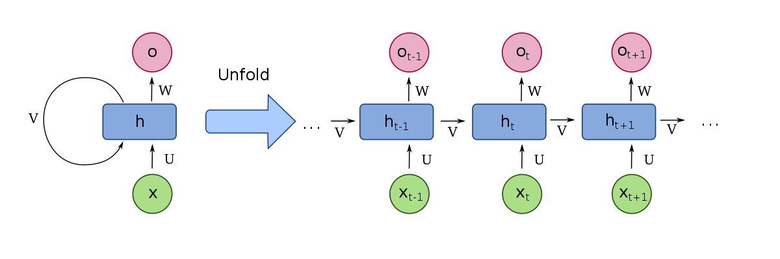
TIME-SERIES MODEL WITH LSTM
Many-to-many sequence
Relu activation
Dropout layer
Logarithmic RMSE

Slide 19
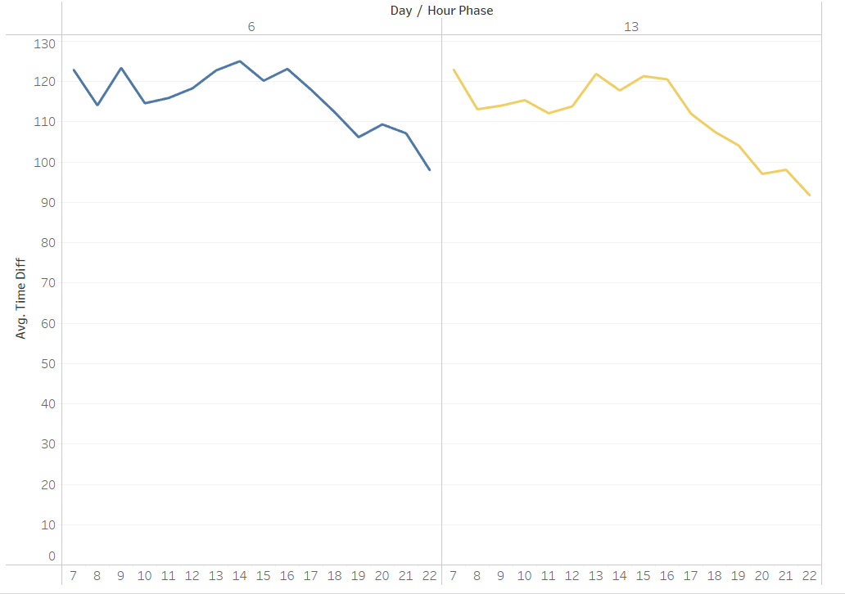
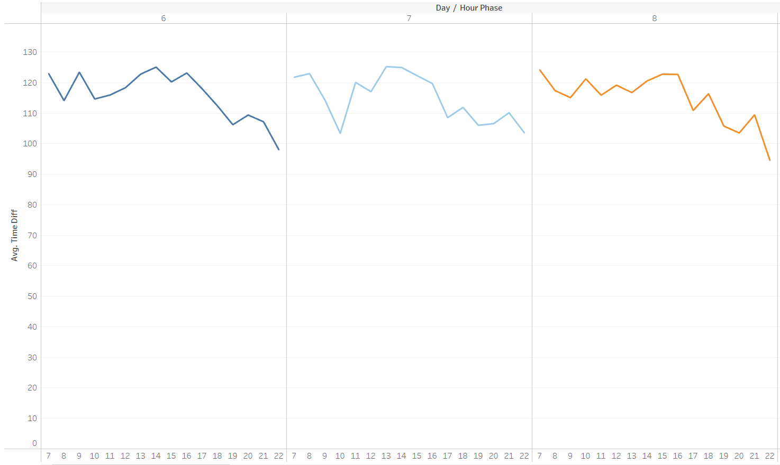
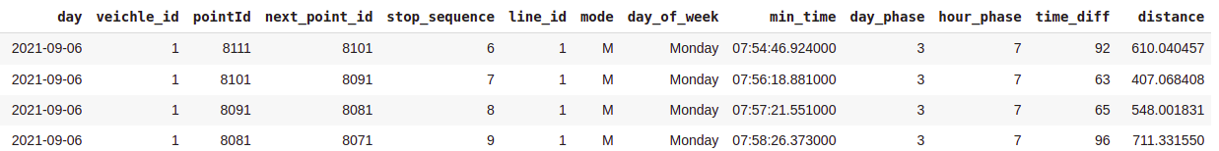
FEATURE SELECTION

Slide 20
TIME-SERIES MODEL WITH LSTM
Many-to-many sequence
Relu activation
Dropout layer
Logarithmic RMSE
time_diff
time_diff:93
time_diff:121
time_diff:187
PointId:
NextPointId:
.
.
.
hourphase:
distance:
PointId:9600
NextPointId:3017
.
.
.
hourphase:7
distance:900
PointId:3017
NextPointId:5048
.
.
.
hourphase:7
distance:1100
PointId:5048
NextPointId:2695
.
.
.
hourphase:7
distance:880

Slide 21
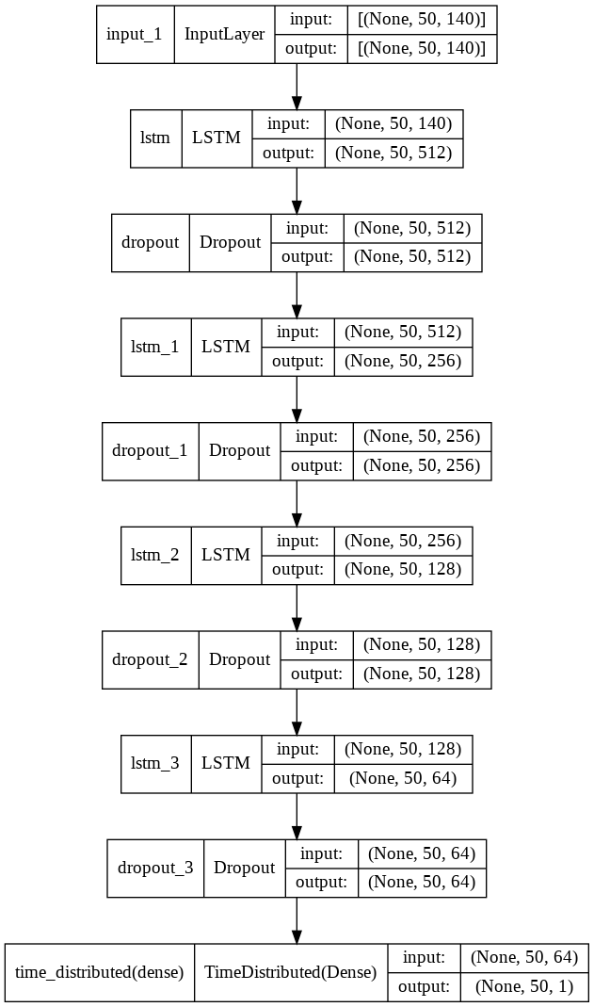
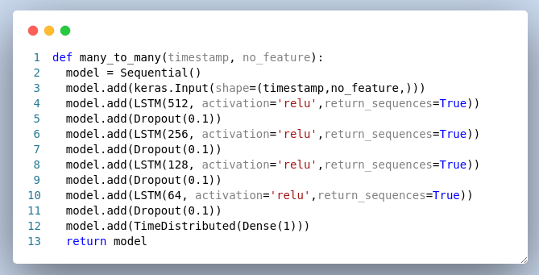
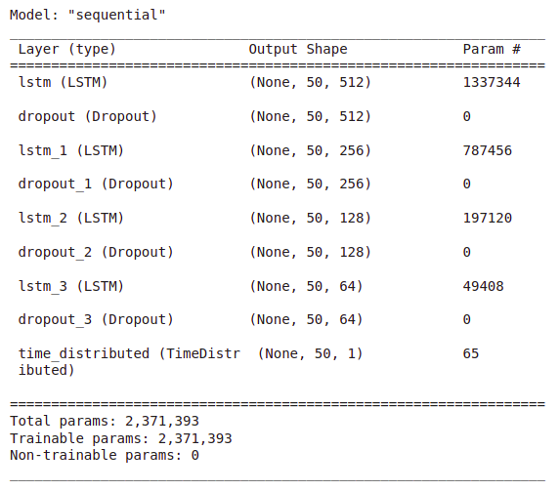
MODEL ARCHITECTURE

Slide 22
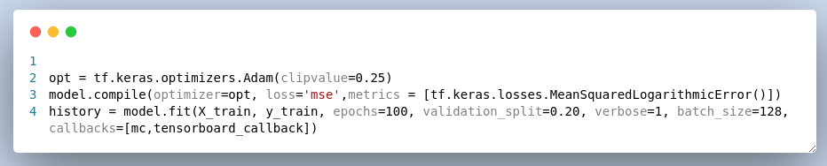
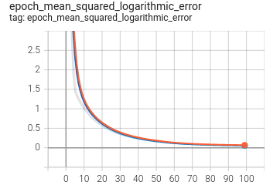
MODEL TRAINING

Slide 23
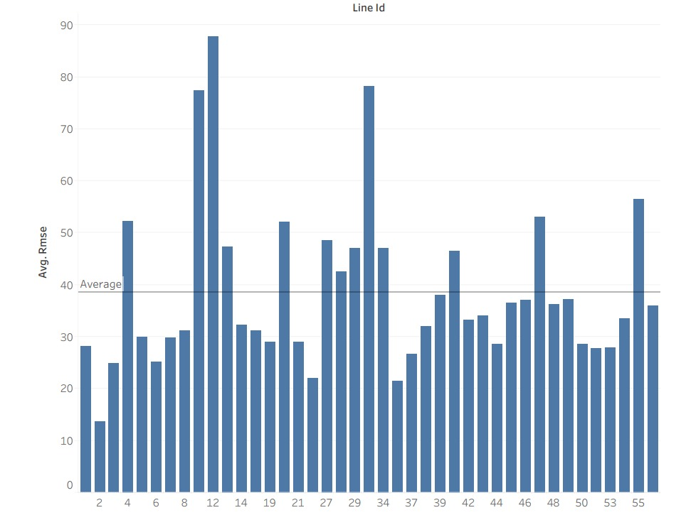
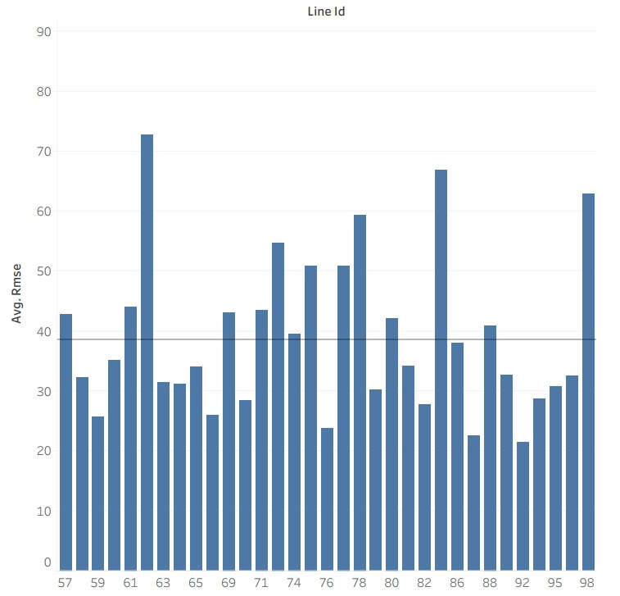
Result Analysis
Test root mean squared error - 38.4304391625181
Average Root Mean Square Error per line ID

Slide 24
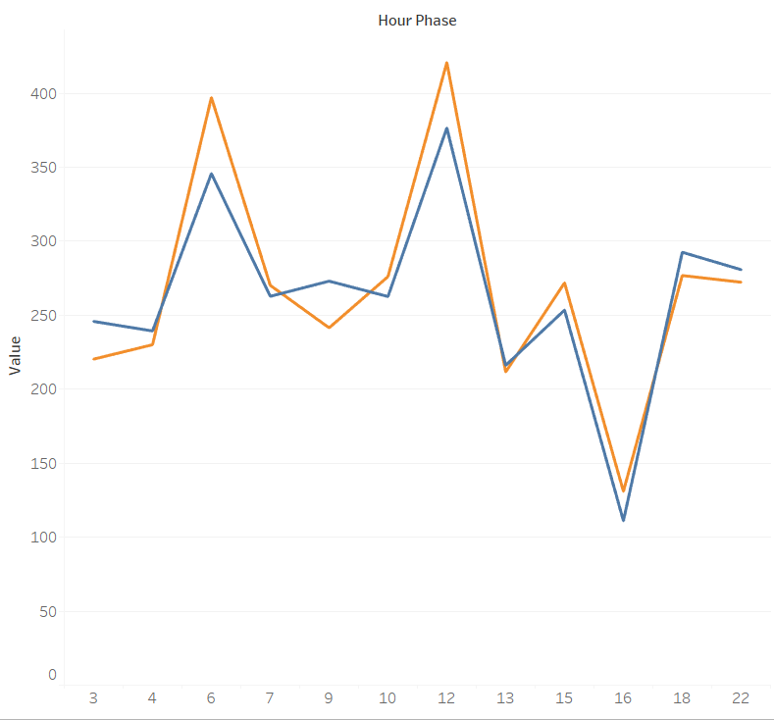
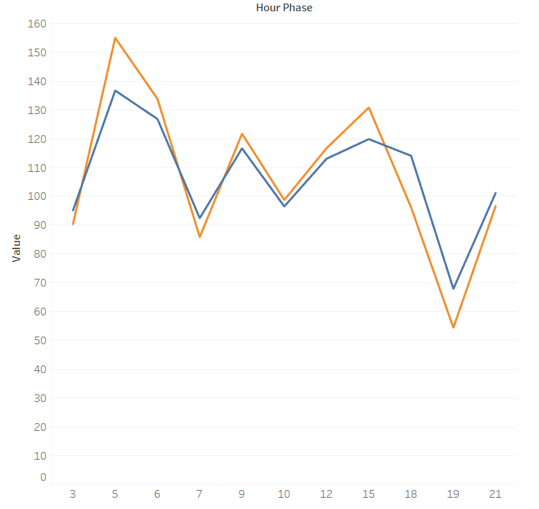

Average time prediction Plots w.r.t each hour
LineId - 71
LineId - 4

Slide 25
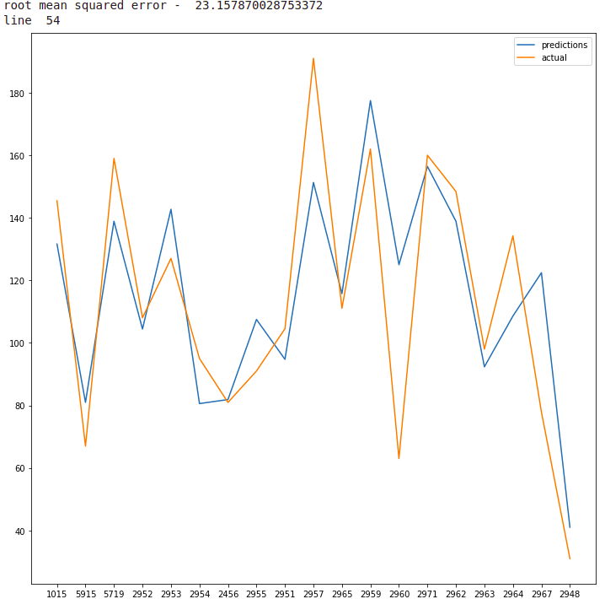
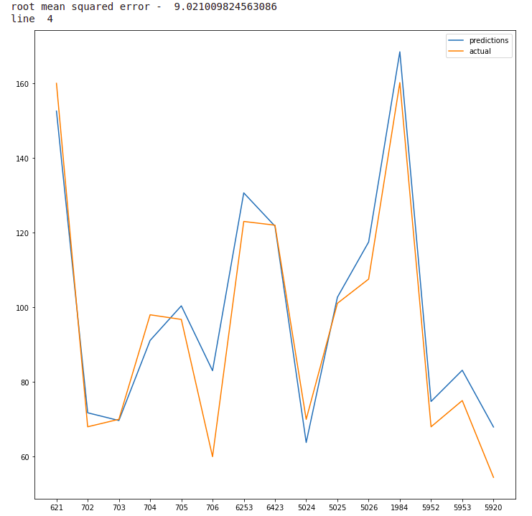
Average time prediction Plots w.r.t each line

Slide 26
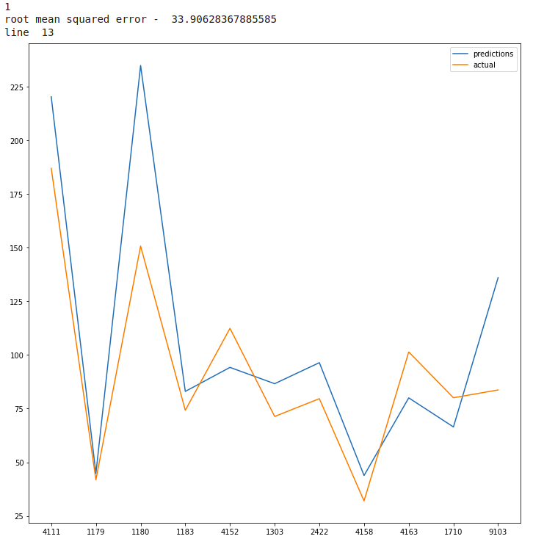
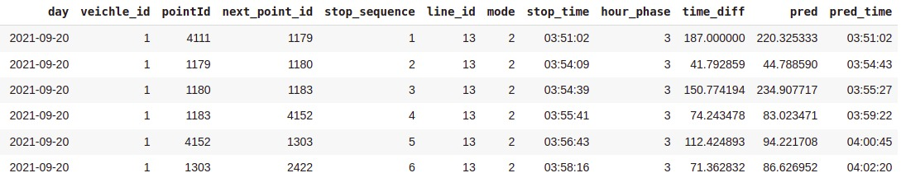
Prediction Dataframe

Slide 27
Task 4: Mode of Transportation

Slide 28
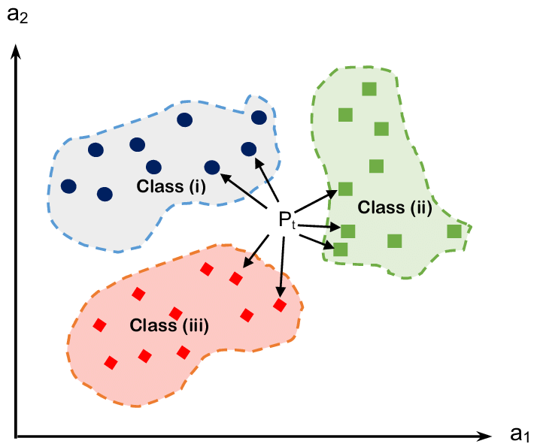
Nearest Neighbour Algorithm:
The algorithm is inspired by k-Nearest Neighbour
Here classes works as the line IDs
For Each Track do -
Set threshold and Loop over all the track points of GPS trajectory
For each Point find the distance with all the lines that are present in line data
If Distance > Threshold (20 meters), increase unmatched count
else keep track of the count of all line IDs that are matched within threshold value
4.Based on the distance and count we give probabilities to the associated lines.

Slide 29
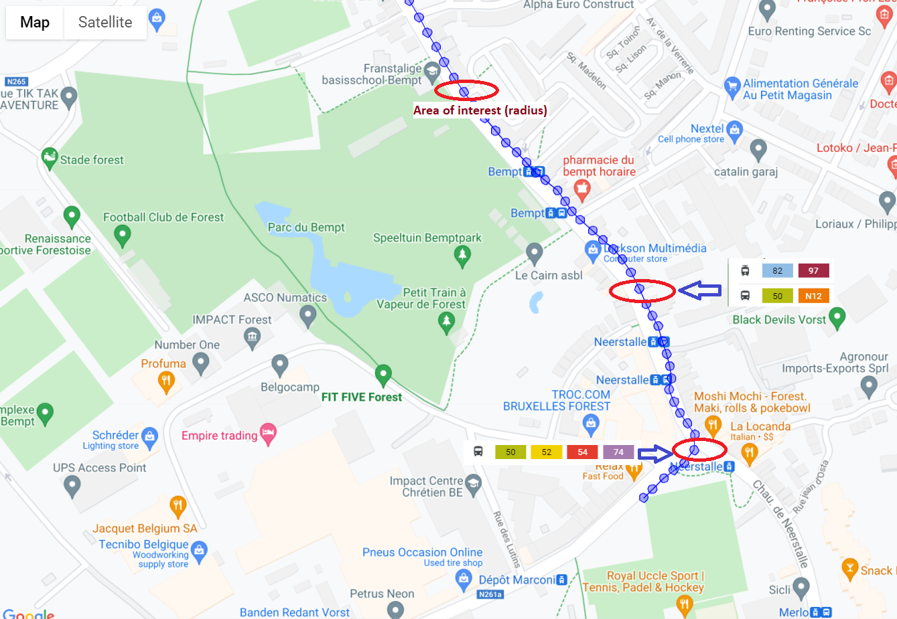
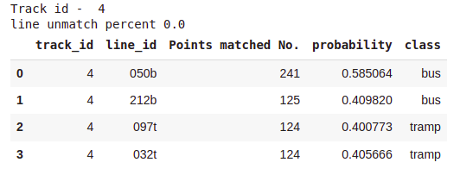

Slide 30
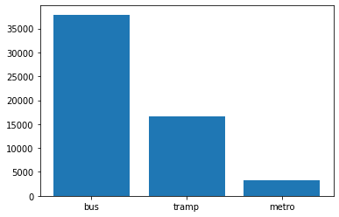
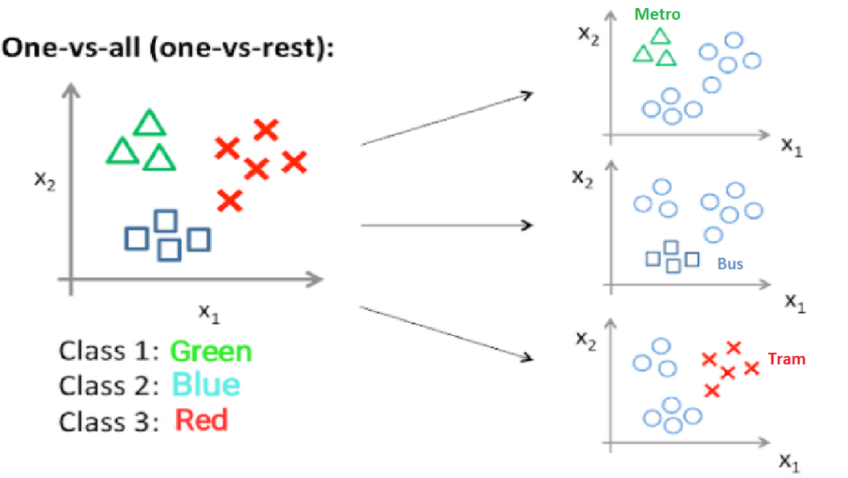
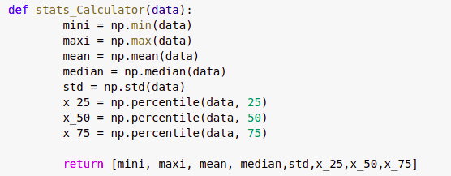
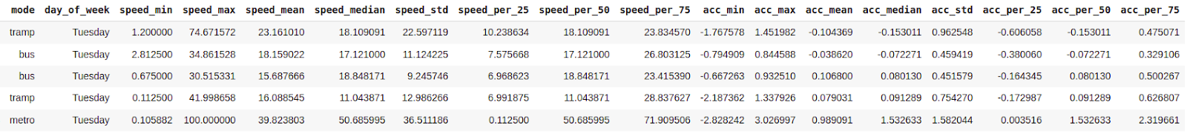
CLASSIFICATION
1.Data Distribution
2.Feature Function
3.Training Data

Slide 31
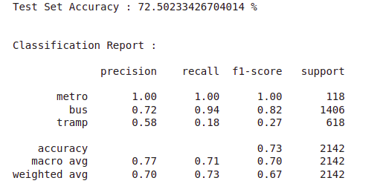
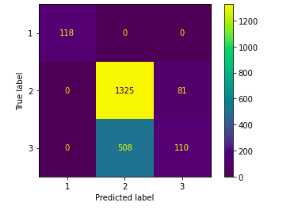
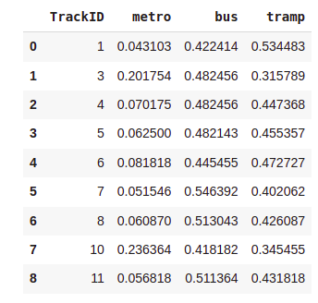
4.Test Set Results
5.Model Predictions
Error Analysis
Different Data Distribution
Higher variability in Training data which is of long durations
More features are required to distinguish between Tram and Metro

Slide 32
FUTURE WORK
Ensemble ARIMA and LSTMs Model to predict the more accurate arrival time
Passenger Data Analysis

Slide 33
THANK YOU

